Slide 1
Architectural Patterns -I
Emre Kaplan, Ph.D.

Slide 2
Architectural Design Patterns
Broker
Transaction Processing
Pipe and Filter
Service oriented Architecture (SoA)
Message Oriented Middleware (MoM)
Three-Tier Architecture
Model-View-Controller (MVC)
Microservices
Command Query Responsibility Segregation (CQRS)
Unit of Work
Data Transfer Object

Slide 3
Software Architecture
Software architecture is process of designing the global organization of a software system, including:
Dividing software into subsystems.
Deciding how these will interact.
Determining their interfaces.
The architecture is the core of the design, so all software engineers need to understand it.
The architecture will often constrain the overall efficiency, reusability and maintainability of the system.

Slide 4
The importance of software architecture
Why you need to develop an architectural model:
To enable everyone to better understand the system
To allow people to work on individual pieces of the system in isolation
To prepare for extension of the system
To facilitate reuse and reusability

Slide 5
Contents of a good architectural model
A system’s architecture will often be expressed in terms of several different views
The logical breakdown into subsystems
The interfaces among the subsystems
The dynamics of the interaction among components at run time
The data that will be shared among the subsystems
The components that will exist at run time, and the machines or devices on which they will be located

Slide 6
Design stable architecture
To ensure the maintainability and reliability of a system, an architectural model must be designed to be stable.
Being stable means that the new features can be easily added with only small changes to the architecture

Slide 7
Developing an architectural model
Start by sketching an outline of the architecture
Based on the principal requirements and use cases
Determine the main components that will be needed
Choose among the various architectural patterns
Discussed next
Suggestion: have several different teams independently develop a first draft of the architecture and merge together the best ideas

Slide 8
Developing an architectural model
Refine the architecture
Identify the main ways in which the components will interact and the interfaces between them
Decide how each piece of data and functionality will be distributed among the various components
Determine if you can re-use an existing framework, if you can build a framework
Consider each use case and adjust the architecture to make it realizable
Mature the architecture

Slide 9
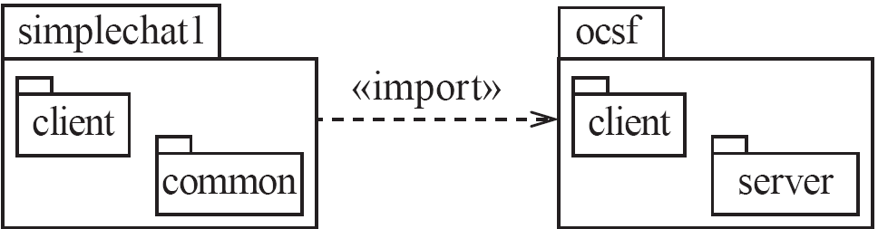

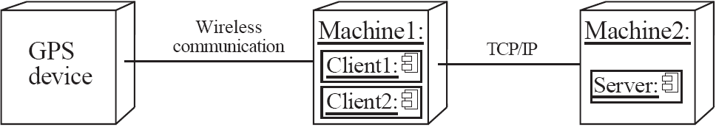
Describing an architecture using UML
All UML diagrams can be useful to describe aspects of the architectural model
Four UML diagrams are particularly suitable for architecture modelling:
Package diagrams
Subsystem diagrams
Component diagrams
Deployment diagrams

Slide 10
The Client-Server and other distributed architectural patterns
There is at least one component that has the role of server, waiting for and then handling connections.
There is at least one component that has the role of client, initiating connections in order to obtain some service.

Slide 11
Thin and fat clients
Thin-client model
In a thin-client model, all of the application processing and data management is carried out on the server.
The client is simply responsible for running the UI.
Fat-client model
In this model, the server is only responsible for data management.
The software on the client implements the application logic and the interactions with the system user.

Slide 12
Thin client model
Used when legacy systems are migrated to client server architectures.
The legacy system acts as a server in its own right with a graphical interface implemented on a client.
A major disadvantage is that it places a heavy processing load on both the server and the network.

Slide 13
Fat client model
More processing is delegated to the client as the application processing is locally executed.
Most suitable when the capabilities of the client system are known in advance.
More complex than a thin client model especially for management. New versions of the application have to be installed on all clients.

Slide 14
Architectural Patterns
The notion of patterns can be applied to software architecture.
These are called architectural patterns or architectural styles.
Each allows you to design flexible systems using components
The components are as independent of each other as possible.

Slide 15
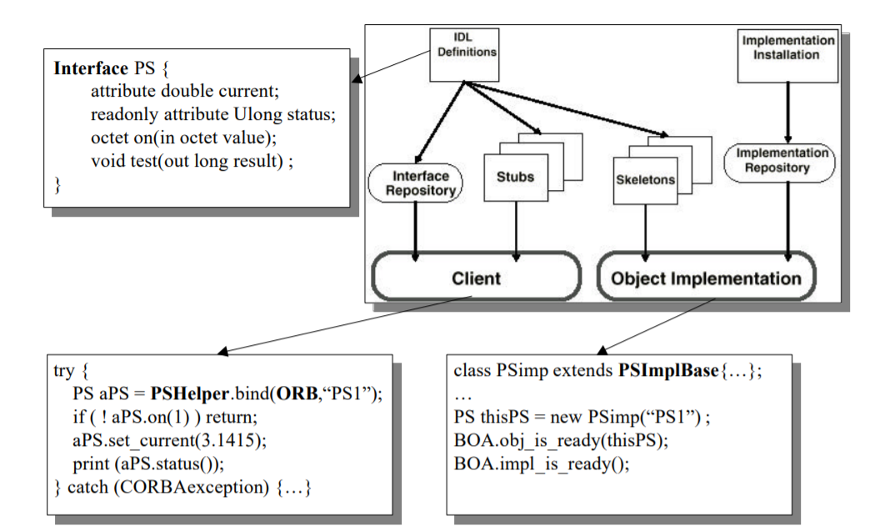
The Broker architectural pattern
Transparently distribute aspects of the software system to different nodes
An object can call methods of another object without knowing that this object is remotely located.
Common Object Request Broker Architecture (CORBA) is a well-known open standard that allows you to build this kind of architecture.
http://www.eso.org/~tcsmgr/oowg-forum/Seminars/CORBAtutorial/CORBAtutorial.pdf

Slide 16
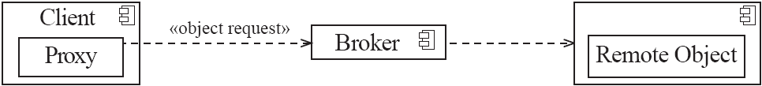
Example of a Broker system

Slide 17
The Transaction-Processing architectural pattern
A process reads a series of inputs one by one.
Each input describes a transaction – a command that typically make some changes to the data stored by the system
There is a transaction dispatcher component that decides what to do with each transaction
This dispatches a procedure call or message to one of a series of component that will handle the transaction

Slide 18
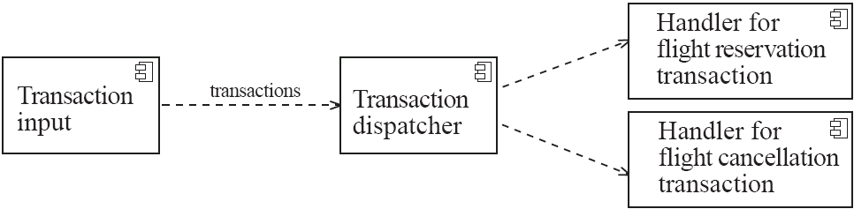
Example of a transaction-processing system

Slide 19
The Pipe-and-Filter architectural pattern
A stream of data, in a relatively simple format, is passed through a series of processes
Each of which transforms it in some way.
Data is constantly fed into the pipeline.
The processes work concurrently.
The architecture is very flexible.
Almost all the components could be removed.
Components could be replaced.
New components could be inserted.
Certain components could be reordered.

Slide 20
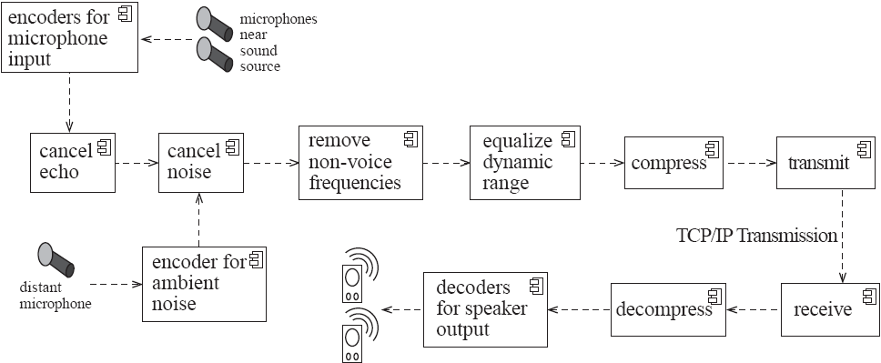
Example of a pipe-and-filter system

Slide 21
The Message-oriented architectural pattern
Under this architecture, the different sub-systems communicate and collaborate to accomplish some task only by exchanging messages.
Also known as Message-oriented Middleware (MOM)
The core of this architecture is an application-to-application messaging system
Senders and receivers need only to know what are the message formats
In addition, the communicating applications do not have to be available at the same time (i.e. messages can be made persistent)
The self-contained messages are sent by one component (the publisher) through virtual channels (topics) to which other interested software components can subscribe (subscribers)

Slide 22
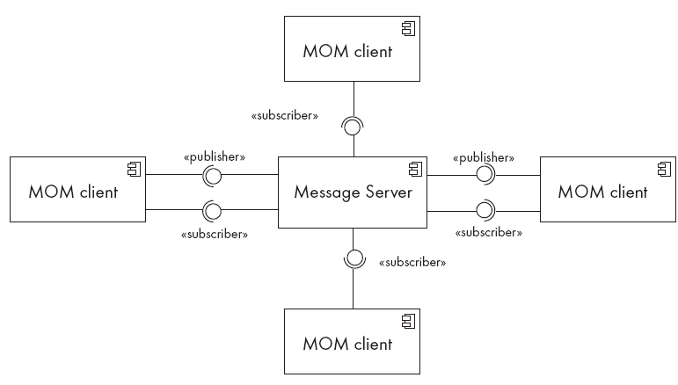
Example of a Message-oriented application

Slide 23
The Multi-Layer architectural pattern
In a layered system, each layer communicates only with the layer below it.
Each layer has a well-defined interface used by the layer immediately above.
The higher layer sees the lower layer as a set of services.
A complex system can be built by superposing layers at increasing levels of abstraction.
It is important to have a separate layer for the UI.
Layers immediately below the UI layer provide the application functions determined by the use-cases.
Bottom layers provide general services.
e.g. network communication, database access

Slide 24
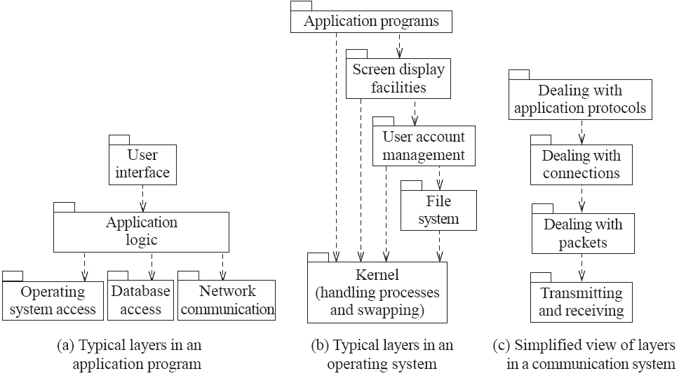
Example of multi-layer systems

Slide 25
Three-tier architectures
User interface layer (presentation layer)
Concerned with presenting the results of a computation to system users and with collecting user inputs.
Application logic layer
Concerned with providing application specific functionality e.g., in a banking system, banking functions such as open account, close account, etc.
Data management layer
Concerned with managing the system databases.

Slide 26
Three-tier architectures
In a three-tier architecture, each of the application architecture layers may execute on a separate processor.
Allows for better performance than a thin-client approach and is simpler to manage than a fat-client approach.
A more scalable architecture - as demands increase, extra servers can be added.

Slide 27
MVC
MVC consists of three kinds of objects.
The Model is the application object,
the View is its screen presentation,
the Controller defines the way the user interface reacts to user input.
Before MVC, user interface designs tended to lump these objects together. MVC decouples them to increase flexibility and reuse.
MVC decouples views and models by establishing a subscribe/notify protocol between them. This approach lets you attach multiple views to a model to provide different presentations. You can also create new views for a model without rewriting it.
Whenever the model's data changes, the model notifies views that depend on it.
In response, each view gets an opportunity to update itself.

Slide 28
The Model-View-Controller (MVC) architectural pattern
An architectural pattern used to help separate the user interface layer from other parts of the system
The model contains the underlying classes whose instances are to be viewed and manipulated
The view contains objects used to render the appearance of the data from the model in the user interface
The controller contains the objects that control and handle the user’s interaction with the view and the model
The Observer design pattern is normally used to separate the model from the view

Slide 29
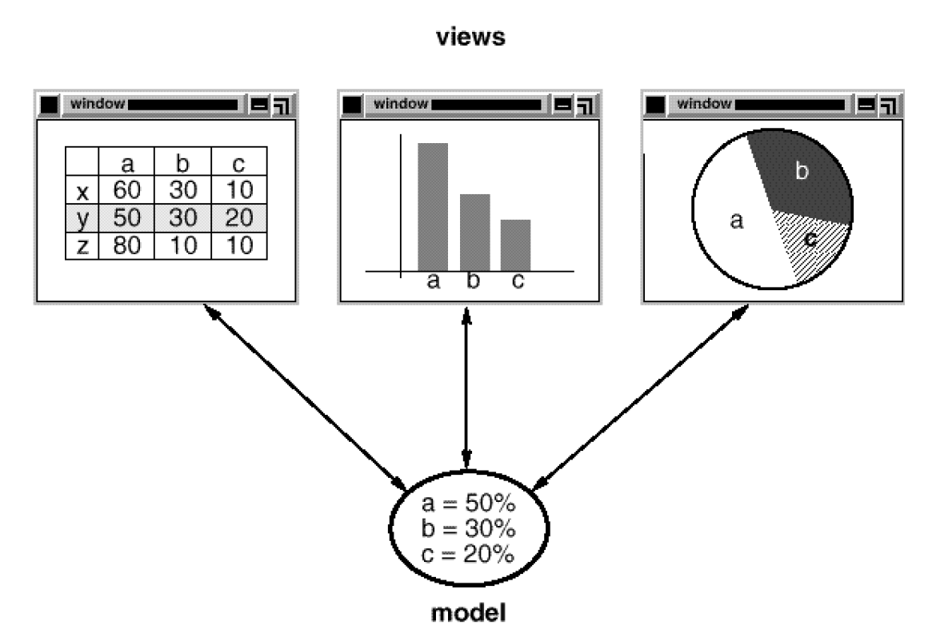
MVC
MVC encapsulates the response mechanism in a Controller object. There is a class hierarchy of controllers, making it easy to create a new controller as a variation on an existing one.

Slide 30
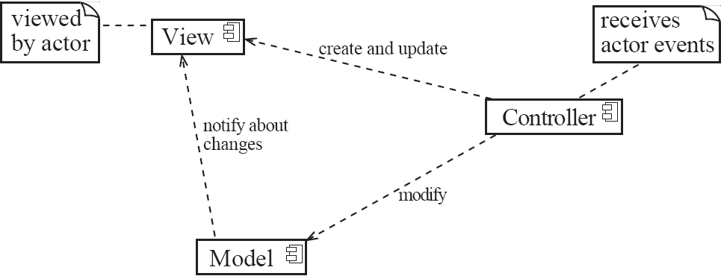
Example of the MVC architecture for the UI

Slide 31
Example of MVC in Web architecture
The View component generates the HTML code to be displayed by the browser.
The Controller is the component that interprets ‘HTTP post’ transmissions coming back from the browser.
The Model is the underlying system that manages the information.

Slide 32
The Service-oriented architectural pattern
This architecture organizes an application as a collection of services that communicates using well-defined interfaces
In the context of the Internet, the services are called Web services
A web service is an application, accessible through the Internet, that can be integrated with other services to form a complete system
The different components generally communicate with each other using open standards such as XML and/or JSON.

Slide 33
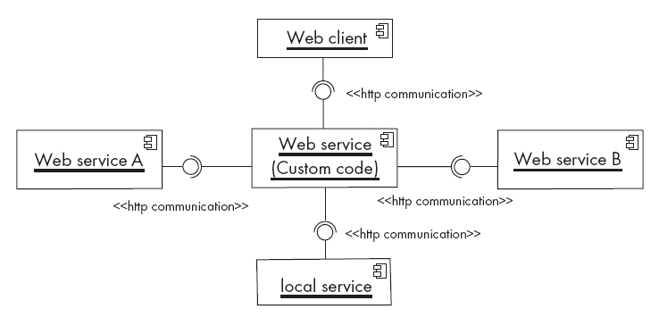
Example of a service-oriented application

Slide 34
Microservices
Modern SoA
Deploying on the cloud, breaking into small parts → microservices ??
In microservice architecture, multiple loosely coupled services work together. Each service focuses on a single purpose and has a high cohesion of related behaviors and data.
They are functional decomposition or domain-driven design, well-defined interfaces, explicitly published interface, single responsibility principle, and potentially polyglot.
Each service is fully autonomous and full-stack. Thus changing a service implementation has no impact to other services as they communicate using well-defined interfaces.
https://medium.engineering/microservice-architecture-at-medium-9c33805eb74f
http://blog.arungupta.me/microservice-design-patterns/

Slide 35
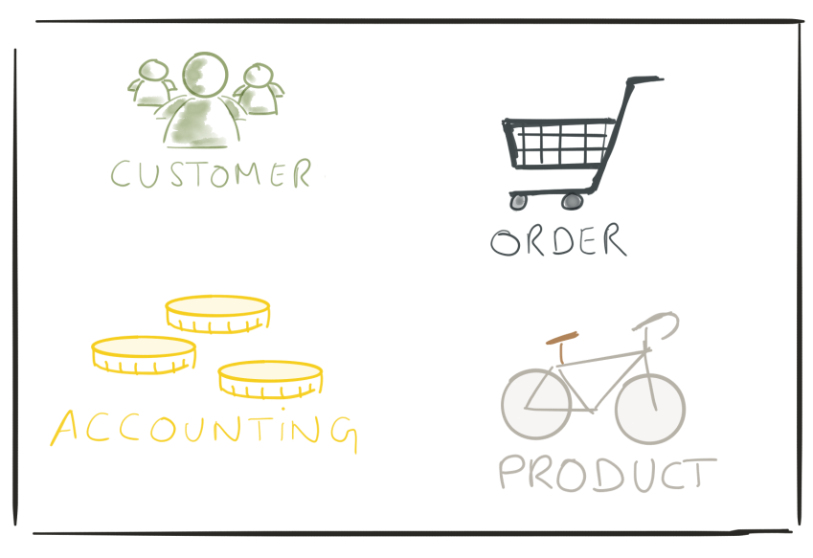
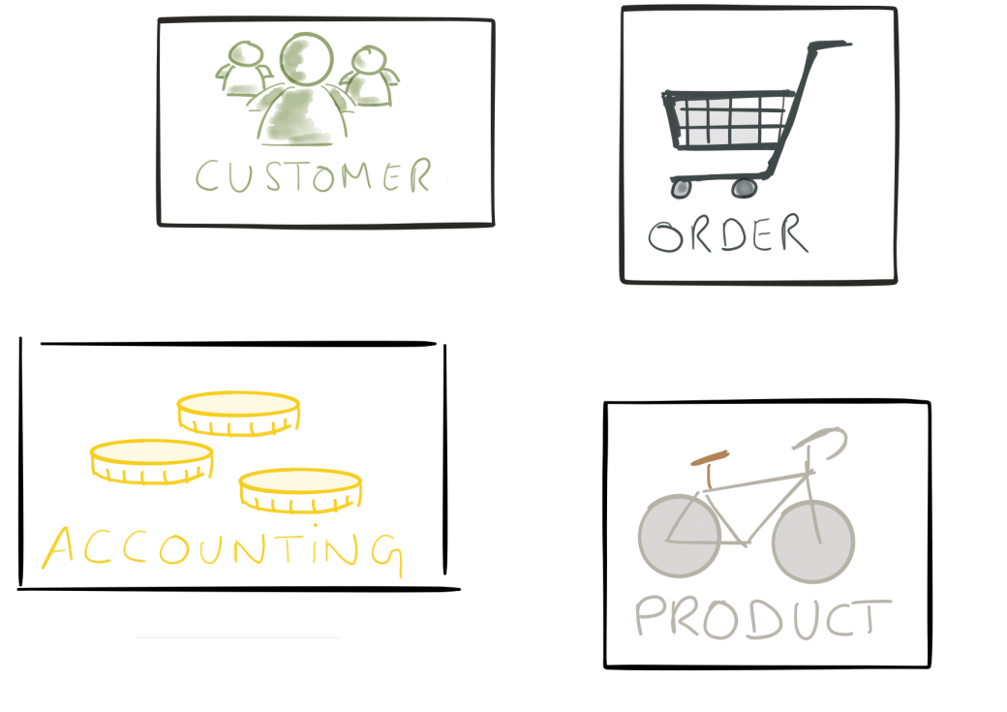
Microservices
A monolith app
Microservices
Notes:
Figures from Samuel Masué, CERN Introduction to microservices

Slide 36
Microservices Goals
Four goals to consider Microservices:
Reduce Cost
it will reduce the overall cost of designing, implementing, and maintaining IT services.
Increase Release Speed
it will increase the speed from idea to deployment of services.
Improve Resilience
it will improve the resilience of our service network.
Enable Visibility
it supports for better visibility on your service and network.
“Microservice Architecture: Aligning Principles, Practices, and Culture” Book by Irakli Nadareishvili, Matt McLarty, and Michael Amundsen

Slide 37
Microservices Design Principles
Microservices Design Principles
Single purpose
each service should focus on one single purpose and do it well.
Loose coupling
services know little about each other. A change to one service should not require changing the others.
Communication between services should happen only through public service interfaces.
High cohesion
each service encapsulates all related behaviors and data together.
https://medium.engineering/microservice-architecture-at-medium-9c33805eb74f

Slide 38
Microservices Characteristics
Characteristics of Microservices
Services are small, independent, and loosely coupled.
Each service is a separate codebase.
Services can be deployed independently.
Services are responsible for persisting their own data or external state.
Services communicate with each other by using well-defined APIs.
Services don't need to share the same technology stack, libraries, or frameworks.
Building Real World Node.JS Microservices on Azure James Truitt Microsoft

Slide 39
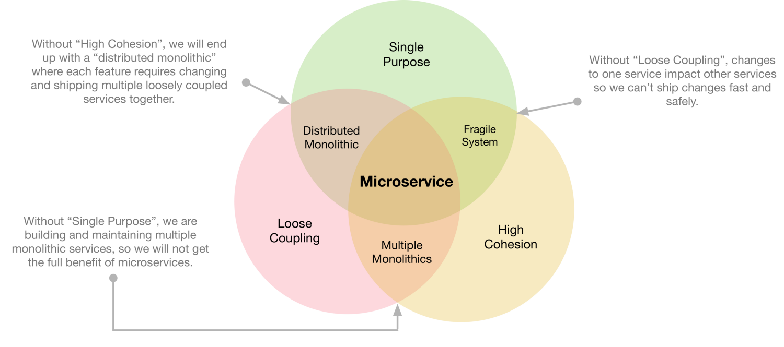
Microservices
https://medium.engineering/microservice-architecture-at-medium-9c33805eb74f

Slide 40
Core Principles of Microservices
Core Principles of Microservices
Single Business Function
A user story, a complete feature?
Loosely Coupled
No duplication
Fail Fast & Fail Safe
If a Microservice runs into a problem, it should realize this quickly and it should fail gracefully
Abstracted and Independent
Do not depend on “how others are working”
Any unit of code should do its job without exporting any dependency on how it does the job.
Full-stack
By its own, deployable
Stateless
Every request should encapsulate necessary information
https://itnext.io/microservice-how-why-cc40ca95d9f0

Slide 41
Core Principles of Microservices
Microservices are designed to be small, stateless, in(ter)dependent & full-stack application so that it could be deployed in cloud infrastructure.
Small: Microservices are designed to be small. But defining "small" is subjective. Some of the estimation techniques like lines of code, function points, use cases may be used. But they are not recommended estimation techniques in agile.
Stateless: A stateless application handles every request with the information contained only within it. Microservices must be stateless and it must service the request without remembering the previous communications from the external system.
In(ter)dependent: Microservices must service the request independently, it may collaborate with other microservices within the eco-system. For example, a microservice that generates a unique report after interacting with other microservices is an interdependent system. In this scenario, other microservices which only provide the necessary data to reporting microservices may be independent services.
Full-Stack Application: A full stack application is individually deploy-able. It has its own server, network & hosting environment. The business logic, data model and the service interface (API / UI) must be part of the entire system. Microservice must be a full stack application.
https://dzone.com/articles/microservices-design-principles
Notes:
In the book Building Microservices the author Sam Newman suggest few techniques to define the size of microservice,
It should be small enough to be owned by a small agile development team,
re-writable within one or two agile sprints ( typically two to four weeks) or the complexity does not require to refactoring or require further divide into another microservice.

Slide 42
Microservices – Best Practices
Model services around the business domain
Decentralize everything
Data storage should be private to the service that owns the data
Services communicate through well-designed APIs
Avoid coupling between services
Offload cross-cutting concerns, such as authentication and SSL termination, to the gateway
Keep domain knowledge out of the gateway
Services should have loose coupling and high functional cohesion
Isolate failures
Building Real World Node.JS Microservices on Azure James Truitt Microsoft

Slide 43
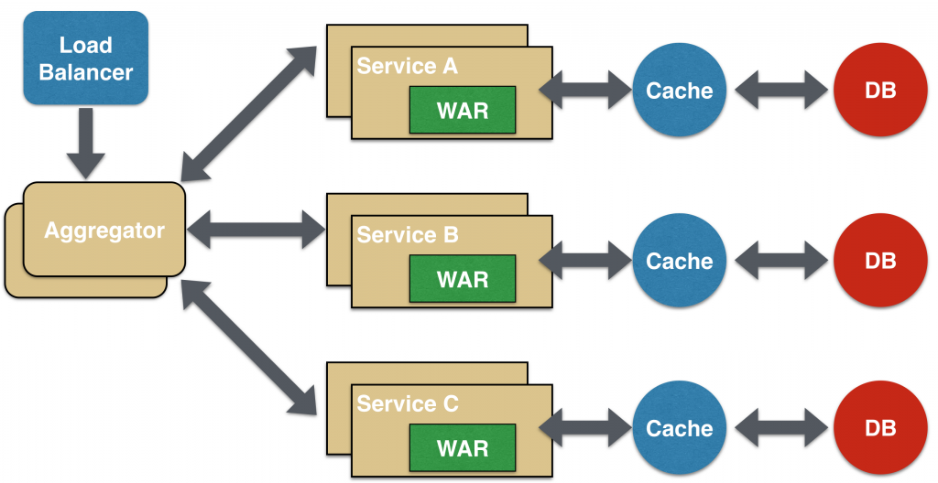
Microservices - Aggregator
Aggregator would be a simple web page that invokes multiple services to achieve the functionality required by the application.
Notes:
http://blog.arungupta.me/microservice-design-patterns/

Slide 44
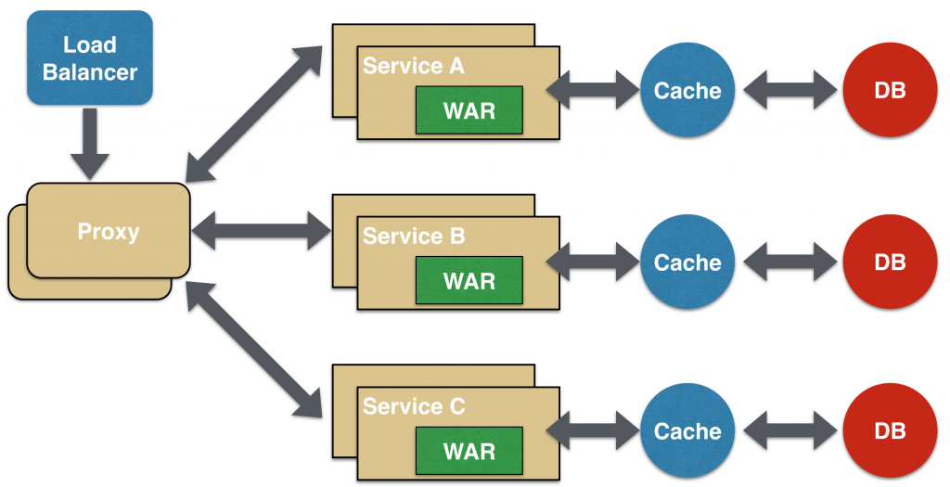
Microservices - Proxy
No aggregation needs to happen on the client but a different microservice may be invoked based upon the business need.
Notes:
http://blog.arungupta.me/microservice-design-patterns/

Slide 45
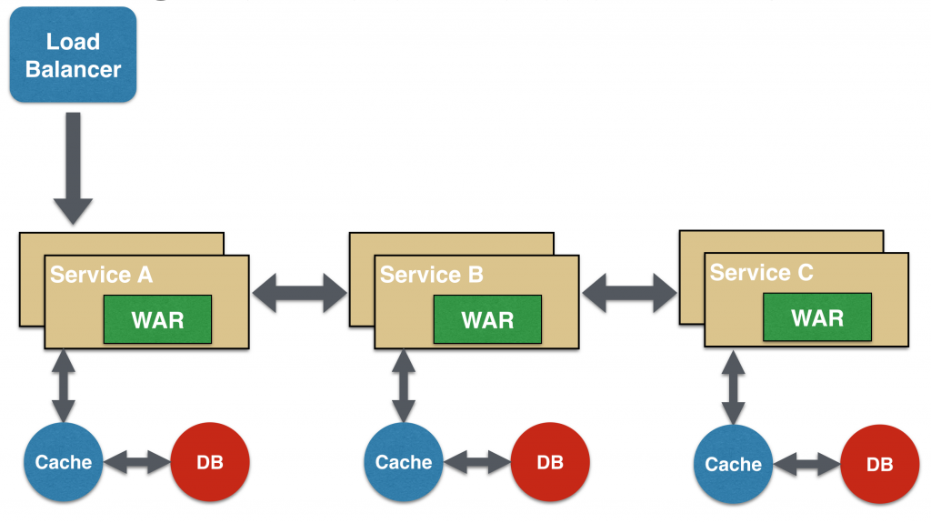
Microservices - Chained
Produce a single consolidated response to the request. The request from the client is received by Service A, which is then communicating with Service B, which in turn may be communicating with Service C. All the services are likely using a synchronous HTTP request/response messaging.
Notes:
http://blog.arungupta.me/microservice-design-patterns/

Slide 46
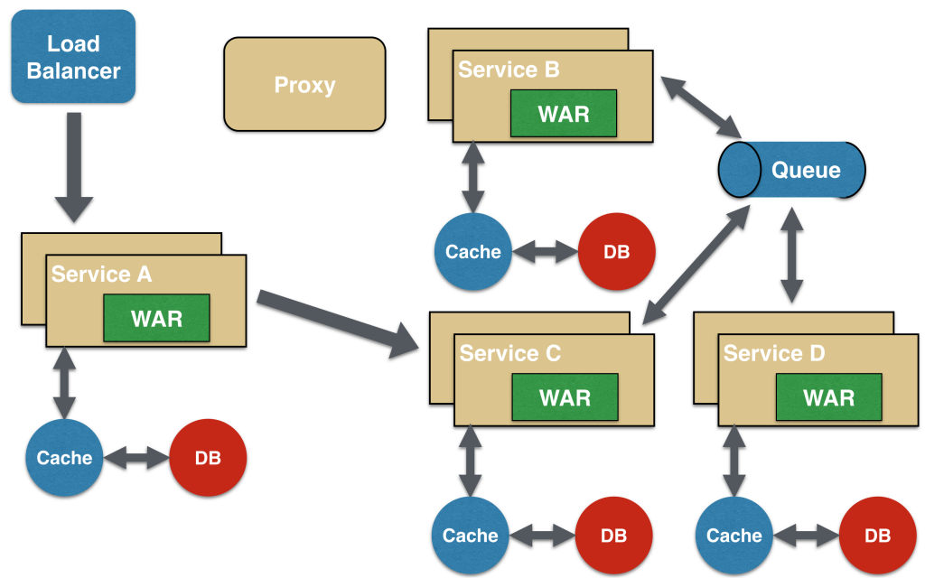
Microservices - Asynchronous
Some microservice architectures may elect to use message queues instead of REST request/response to achieve async.
Service A may call Service C synchronously which is then communicating with Service B and D asynchronously using a shared message queue.
Service A -> Service C communication may be asynchronous, possibly using WebSocket, to achieve the desired scalability.
WebSocket: There is an persistent connection between the client and the server and both parties can start sending data at any time.
Notes:
http://blog.arungupta.me/microservice-design-patterns/

Slide 47
References
Lethbridge/Laganière Object-Oriented Software Engineering Practical Software Development using UML and Java Chp.9 2005
Further reading about Microservice Design Patterns
https://medium.com/@madhukaudantha/microservice-architecture-and-design-patterns-for-microservices-e0e5013fd58a
http://blog.arungupta.me/microservice-design-patterns/

